Slide 1
Visual Analytics in Deep Learning: An Interrogative Survey for the Next Frontiers
Cullen Buchanan, Ron Neely, Jason Snouffer, and Jonathan Vedro
Rowan - Information Visualization
April 18, 2019
Notes:
Ron

Slide 2







Inputs -> Deep Learning Model -> Outputs
Recommendations
1 2 3
4
Notes:
Ron

Slide 3
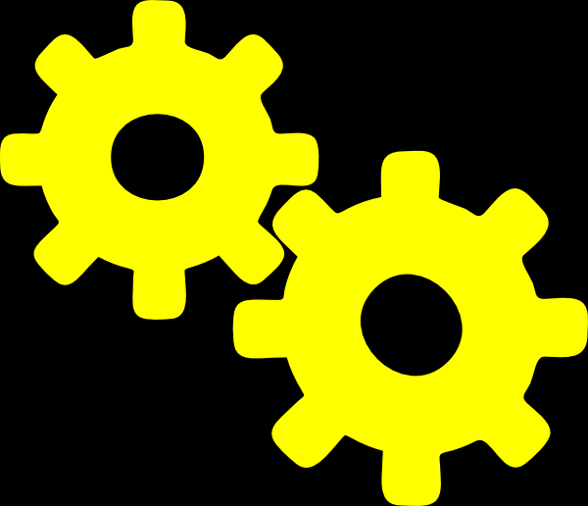
Inputs -> Deep Learning Model -> Outputs
Recommendations
1 2 3
4
?
Training
Testing
Validation
Notes:
Ron

Slide 4
Why do we care?
Neural Network:
Interpretability
How does it work?
Security
Has it been compromised?
Trust
Is it correctly working?
?
Notes:
Ron

Slide 5
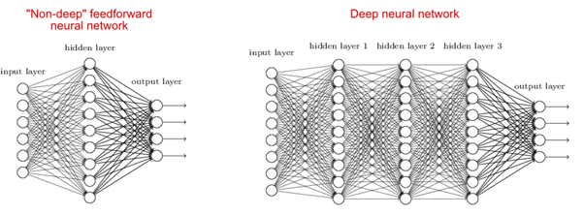
What is deep learning?
shallow
Deep learning is a speciﬁc set of techniques from the broader ﬁeld of machine learning (ML) that focus on the study and usage of deep artiﬁcial neural networks to learn structured representations of data.
The barrier to developing deep learning models is lower than ever before and deep learning applications are becoming pervasive.
While this technological progress is impressive, it comes with unique and novel challenges.
They will likely become even more widespread as more AI-powered systems are deployed in the world. Therefore, a general sense of model understanding is not only beneﬁcial, but often required to address the aforementioned issues.
deep
Notes:
Jonathan

Slide 6
How will Data Vis help deep learning?
Data visualization and visual analytics excel at knowledge communication and insight discovery by using encodings to transform abstract data into meaningful representations.
Deconvolutional networks
Over just a handful of years, many different techniques have been introduced to help interpret what neural networks are learning.
Interaction has also been incorporated into the model understanding process in visual analytics tools to help people gain insight.
In this survey, we summarize a large number of deep learning visualization works using the Five W’s and How.
Notes:
Jonathan

Slide 7
Who would use and benefit from visualizing deep learning?
What data, features, and relationships in deep learning can be visualized?
Model Developers & Builders
Model Users
Non-experts
Computational Graph & Network Architecture
Learned Model Parameters
Individual Computational Units
Neurons in High-dimensional Space
Aggregated Information

Slide 8
Where has deep learning visualization been used?
When is the deep learning process visualization process used?
Application Domains and Models
Vibrant Research Community
During Training
After Training

Slide 9
How can we visualize deep learning data, features, and relationships?
Why would one want to use visualization in deep learning?
Node-link diagrams for network architecture
Dimensionality reduction & scatter plots
Line charts for temporal metrics
Instance-based analysis and exploration
Interactive experimentation
Algorithms for attribution and feature visualization
Interpretability and Explainability
Debugging & Improving Models
Comparing & Selecting Models
Teaching Deep Learning Concepts

Slide 10
5 Ws & How Example
To interpret representations learned by deep models (why),
model developers (who)
visualize neuron activations in convolutional neural networks (what)
using t-SNE embeddings (how)
after the training phase (when)
to solve an urban planning problem (where).
Notes:
Ron

Slide 11
Visualization/AI
Workshops, Journals, and Conferences
Acronym | Full Name
VAST | IEEE Conference on Visual Analytics Science and Technology
CVPR | Conference on Computer Vision and Pattern Recognition
VADL | IEEE VIS Workshop on Visual Analytics for Deep Learning
FILM | Workshop on Interpretation and Visualization of Deep Neural Nets
Notes:
Cullen

Slide 12
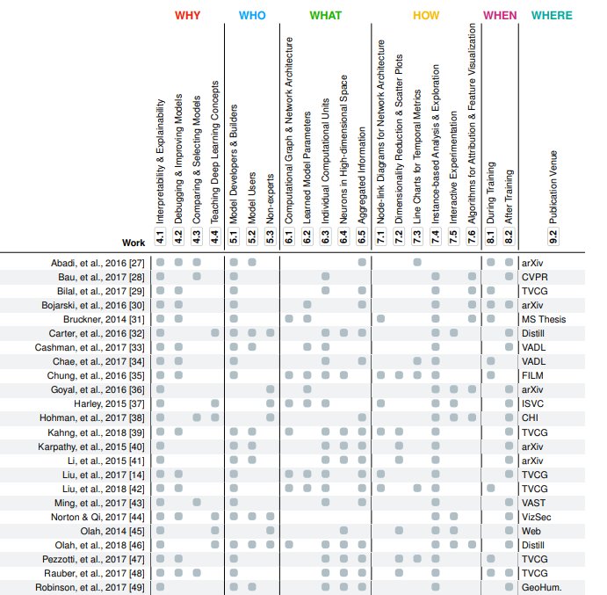
Noteable Papers
Notes:
Cullen

Slide 13
Why - Differences in Interpretability and Explainability
Interpretability
Directly explain what is happening within a given model.
Describe exactly what is happening within the model/algorithms.
Explainability
An explanation can show predictions without elucidating the mechanisms by which models work.
Explain the model in “human terms”
Notes:
Cullen

Slide 14
Why - Areas of Application
Debugging
Help track hyperparameters, misclassifications, and more
Improving
Iterative process, display the trends of past models
Comparing and Selecting
Visually see how models are performing in comparison to another
Teaching/Education
Help teach beginners ML, architecture, algorithms and more
Notes:
Cullen

Slide 15
Who uses it
This section describes the groups of people who may stand to beneﬁt from deep learning visualization and visual analytics.
Model developers
Model users
Non-experts
Notes:
Jason

Slide 16
Who uses it - Developers/Builders
Individuals whose job is primarily focused on developing, experimenting with, and deploying deep neural networks.
Have a strong understanding of deep learning techniques and a well-developed intuition surrounding model building.
Typically seasoned in building large-scale models and training them on high-performance machines.
Tooling and research is much more technically focused
Notes:
Jason

Slide 17
Who uses it - Users
These are users who may have some technical background but are neural network novices. They also include machine learning artists who use models to enable and showcase new forms of artistic expression.
Notes:
Jason

Slide 18
Who uses it - Non-experts (education)
Individuals who typically have no prior knowledge about deep learning may or may not have a technical background. They also include people who simply use AI-powered devices and consumer applications.
Tools built for non-experts, particularly with an educational focus, are becoming more popular on the web.
Notes:
Jason

Slide 19
What to Visualize
This section discusses the technical components of neural networks that could be visualized.
Architecture
Edge Weights
Filters applied
Neuron Activations
Loss function/error measurement
High-dimensional neurons
Groups of instances
Model metrics
Notes:
Jason

Slide 20
What to Visualize - Architecture
Model architecture
The computational / dataflow graph
Deﬁnes how a neural network model would train, test, save data to disk, and checkpoint after epoch iterations.
Deﬁnes how data ﬂows from operation to operation to successfully train and use a model.
Can be visualized to potentially inform model developers of the types of computations occurring within their model.
Notes:
Jason

Slide 21
What to Visualize - Edge Weights
Neural network models are built of many, and sometimes diverse, constructions of layers of neurons.
Each layer sends information to the next layer via edge weights.
Skipping certain layers can lead to better performance.
Each node has an edge with an accompanying weight that sends signal from one neuron in a layer to thousands of neurons in an adjacent layer.
Are tweaked during the back propagation phase of training a deep model, and could be worthwhile to visualize for understanding what the model has learned.
Notes:
Jason

Slide 22
What to Visualize - Filters applied
Convolutional filters
Most Neural Networks use them
Apply filters over the input data (images represented as a two-dimensional matrix of values) to generate smaller representations of the data to pass to later layers in the network.
Updated throughout the training process to support a given task.
Notes:
Jason

Slide 23
What to Visualize - Neuron Activations
Neural networks can be thought as a collection of layers of neurons connected by edge weights.
Neurons too can be a source of data to investigate.
When given a trained model, one can perform inference on the model using a new data instance to obtain the neural network’s output.
The neurons compute activations using activation functions (e.g., weighted sum) to combine the signal from the previous layer into a new node.
During inference, we can recover the activations produced at each layer.
Notes:
Jason

Slide 24
What to Visualize - Cost function/error measurement
Backpropagation (of errors): a method to calculate the gradient of a speciﬁed cost function.
With an optimization algorithm, we can compute the error at the output layer of a neural network and redistribute the error by updating the model weights using the computed gradient.
These gradients ﬂow from the output layer to the input layer.
Could be useful to visualize the gradients of a network to see how much error is produced at certain outputs and where it is distributed.
Notes:
Jason

Slide 25
What to Visualize - High-dimensional neurons
Think of the feature vectors recovered as vectors in a high-dimensional space. Each neuron in a layer then becomes a “dimension.”
We can now take advantage of high-dimensional visualization techniques to visualize extracted activations.
Dimensionality reduction is commonly used here to visualize in 2D or 3D space.
Notes:
Jason

Slide 26
What to Visualize - Groups of instances
Instance-level activations allow one to recover the mapping from data input to a feature vector output.
Can also be done on collections of instances for unique advantages:
One can compute all the activations simultaneously.
Can now compare these individual activations to see how similar or different they are from one another.
Take multiple groups, potentially from differing classes, and compare how the distribution of activations from one group compares or differs from another.
Could be useful for uncovering the learned decision boundary in classiﬁcation tasks.
Notes:
Jason

Slide 27
What to Visualize - Model metrics
Instance- and group-level activations suffer from scalability issues.
An alternative object to visualize are model metrics.
Representing the state of a model through a single number, or handful of numbers, abstracts away much of the subtle and interesting features of deep neural networks. Examples: cost, accuracy, precision, recall, etc.
But they are key indicators for communicating how the network is progressing and provide a quick and easy way to compare multiple models at once.
Notes:
Jason

Slide 28
How to visualize
In the previous section, we described what technical components of neural networks could be visualized.
In this section, we summarize how the components are visualized and interacted with in existing literature.
Network architectures are often represented as node-link diagrams
Embeddings typically represented as scatter plots
Model metrics over time are almost always represented as line charts
Notes:
Jonathan

Slide 29
How to visualize - Node link for data flow
The most common way to visualize where data ﬂows and the magnitude of edge weights is a node-link diagram.
Displaying large numbers of links from complex models can generate “hairball” visualizations where many edge crossings impede pattern discovery.
The weight magnitude and sign can then be encoded using color or link thickness.
Node-link diagrams for network architecture work well for smaller networks, but they also suffer from scalability issues.
Notes:
Jonathan

Slide 30
How to visualize - Reduce dimensionality
The most common technique to visualize embeddings is performing dimensionality reduction to reduce the number of columns/features to 2 or 3.
In the 2D case, we can plot all data instances as points in a scatter plot.
Viewing a 3D space on a 2D medium (e.g., computer screen) may not be ideal for tasks like comparing exact distances.
Another common approach is to retrieve the original image and place it at the reduced coordinate location.
It is also possible to use time-dependent data and visualize how an embedding changes over time, or in the case of deep learning, over epochs.
However, these scatter plots raise problems too. The quality of the embeddings greatly depends on the algorithm used to perform the reduction.
Notes:
Jonathan

Slide 31
How to visualize - Line Charts
Model developers track the progression of their deep learning models by monitoring and observing a number of different metrics computed after each epoch.
Loss
Accuracy
Different measure of errors
Useful for diagnosing the long training process of deep learning models.
The most common visualization technique for visualizing this data is by considering the metrics as time series and plotting them in line charts.
Notes:
Jonathan

Slide 32
How to visualize - Instance-based Analysis
Testing speciﬁc data instances to understand how they progress throughout a model.
One application is to use instances as unit tests for deep learning models.
Confusion matrices
It is also common for experts to perform similar similar tasks using groups of instances.
For textual data, people often use words to group documents and provide aggregated data.
Notes:
Jonathan

Slide 33
How to visualize - Instance-based Analysis
Instead of using individual data instances for testing and debugging a model, experts can further test the model by evaluating its average and aggregate performance across different groups.
Sometimes it can be challenging to deﬁne groups for images or text. For textual data, people often use words to group documents and provide aggregated data.
Notes:
Jonathan

Slide 34
How to visualize - Interactive Experimentation
Interactive experimentation makes heavy use of interactions for users to experiment with models.
By using direct manipulation for testing models, a user can pose “what if?” questions and observe how the input data affects the results.
Called explorable explanations, this type of visual experimentation is popular for making sense of complex concepts and systems.
Many systems require the user to provide some kind of input data into the system to obtain results.
Notes:
Jonathan

Slide 35
How to visualize - Attribution & Feature Visualization
The ﬁnal method for how to visualize deep learning hails from the AI and computer vision communities. These are algorithmic techniques that entail image generation. Given a trained model, one can select a single image instance and use one of the algorithmic techniques to generate a new image of the same size that either highlights important regions of the image (often called attribution) or is an entirely new image that supposedly is representative of the same class (often called feature visualization). In these works, it is common to see large, full-page ﬁgures consisting of hundreds of such images corresponding to multiple images classes.
Notes:
Jonathan

Slide 36
How to visualize - Attribution & Feature Visualization
Generates translucent heatmaps that overlay images to highlight important regions that contribute towards classiﬁcation and their sensitivity.
Invert representations, i.e., attempt to reconstruct an image using a feature vector to understand what a CNN has learned.
Some of these methods fail to provide correct results. Thus, we should develop explanation methods that work on simpler models before extending them to the more complex ones.
Class activation maximization
The techniques developed in this research area have improved dramatically over the past few years, where now it is possibly to synthetically generate photorealistic images. Note that trustworthiness remains questionable.
Notes:
Jonathan

Slide 37
When to visualize
This section describes when visualizing deep learning may be most relevant and useful.
The training process is an iterative, foundational procedure for using deep learning models.
There are two distinct, non-mutually exclusive times for when to visualize: during training and after training.
Visualizing both during and after training is possible.
Notes:
Jonathan

Slide 38
When to visualize - During Training
Artiﬁcial neural networks learn higher-level features that are useful for class discrimination as training progress.
There is potential to monitor one’s model as it learns to closely observe and track the model’s performance.
Dynamic updating
Many of the visual analytics systems used during training support and show these updating visualizations as a primary view in the interface.
Some systems help reduce development time and save computational resources by visualizing metrics that indicate whether a model is successfully learning or not.
Notes:
Jonathan

Slide 39
When to visualize - After Training
This assumes a trained model as input to the system or visualization technique. Many previously mentioned algorithmic techniques are performed after training.
More traditional visual analytics systems have also been developed to inspect a model after it has ﬁnished training to show how model works
Notes:
Jonathan

Slide 40
Where has deep learning visualization been used?
Application Domains
Neural machine translation
Reinforcement learning
Social good
Autonomous vehicles
Medical imaging diagnostics
Urban Planning
Models
CNNs (vision) - classification
RNNs (memory, LSTM) - time series data
memory
GANs (new)
Generative Adversarial Network “Fake Eyes” for training
like pair programming

Slide 41
Where is deep learning visualization research at?
Academic Communities
Information Visualization & Visual Analytics
Artificial Intelligence & Deep Learning
Other (Cutting Edge)
arXiv
Pre-posts of papers
Github
Open source projects
Blog(s)
etc.

Slide 42
Conclusion
Comprehensive timely survey on visualizing deep learning
AI
ML
Computer vision
Visualization helps address
discover insights about model
discern model bias
understand models
promote AI safety
?
Notes:
Ron

Slide 43
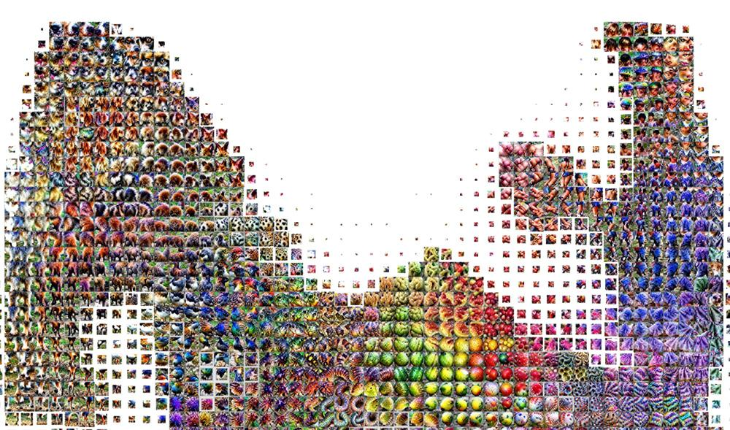
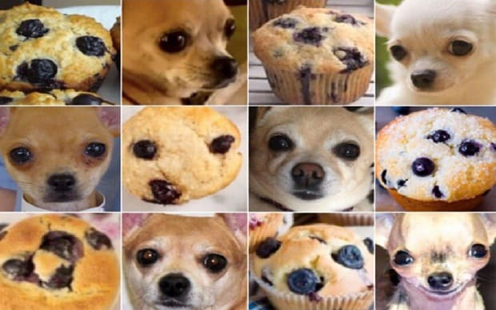
Direction(s) for Research and Problem Application
Furthuring Interpretability
Demo: https://distill.pub/2019/activation-atlas/
System and Visual Scalability - large data
Utility & Usability Studies - user study
Human and/or AI Paring - right controls “tune as you train”
Social Good & Bias Detection - ethical, fair, & safe
Protect Against Adversarial Attacks
Notes:
Ron

Slide 45
Questions?
Notes:
Ron

